Slide 1
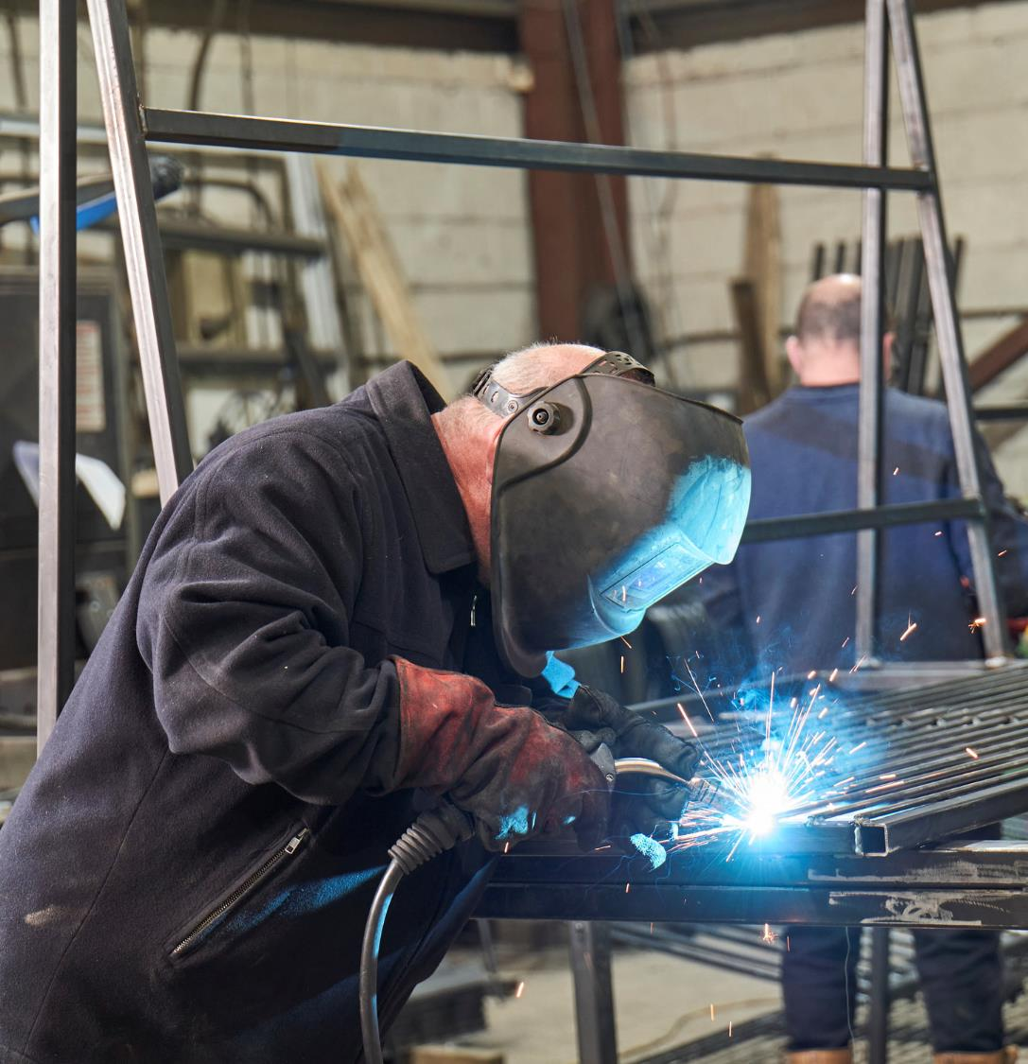


50+ Employment support in greater Manchester
Summary of stage 1: co-creation

Slide 2
Project background
The Centre for Ageing Better in partnership with the Greater Manchester Combined Authority and the Department for Work and Pensions are working on a project to improve the economic activity rate amongst people aged 50 to State Pension age.
As part of this we commissioned Humanly to develop new approaches to supporting people aged 50 to SPa into work in Greater Manchester.
Humanly are an award-winning design studio specialising in human-centred design for social impact.

Slide 3
Project approach
For this project, Humanly used a co-creation approach. Co-creation is the meaningful involvement of people who use the services we’re designing in the design process, as well as other stakeholders. By taking into account their perspectives and experiences, we can design inclusive solutions, products and services that are better suited to people’s needs.
Co-creation activities were targeted in Moss Side and Cheetham Hill in Manchester, Sale in Trafford and Bickershaw in Wigan. Co-creation has been conducted with a range of participants, including people with lived experience, service providers, employers and wider stakeholders.
In total 168 stakeholders were engaged including:
53 People with lived experience
62 GMCA, DWP and local area stakeholders
31 Local service providers
14 Employment and labour market experts
8 Local employers

Slide 4
Initial co-creation activities – people with lived experience
Humanly’s co-creation activities were conducted remotely due to COVID-19, and were designed to be as accessible as possible. Kits were posted to participants with activities, instructions and templates for them to fill in and return.
These templates captured people’s ideas and experiences, including their job seeking journeys and working lives to date, as well as their aspirations for their ideal life over 50 and what support they would need to achieve these ambitions.

Slide 5
Generating ideas
Humanly also ran idea generation activities with people with lived experience and key project stakeholders. These insights and ideas were used to identify six key opportunity areas:
Designing pathways of support by making the support available easy to navigate
Increasing equal access to training
Supporting people to transition back into work
Enabling people to identify and communicate their transferable skills
Helping people to build their networks
Commissioning differently, with a focus on support centred on the person

Slide 6
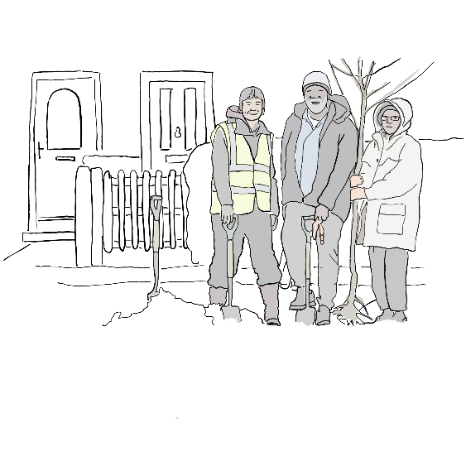
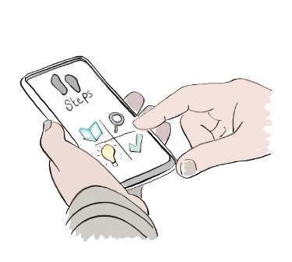
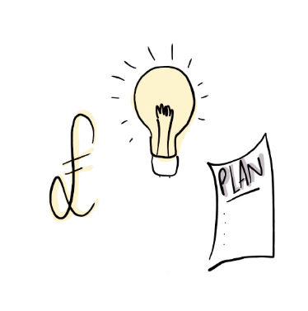
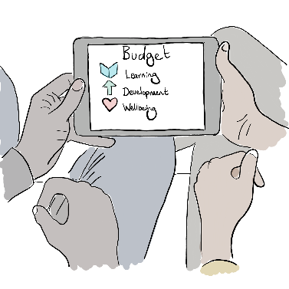
Developing initial concepts
Based on this analysis, six initial concepts were developed to share with people with lived experience and providers for their feedback.
This feedback allowed the six concepts to be narrowed down to four key ideas:
A digital self-service tool with optional coaching support
Meaningful, paid work placements
A person-centred procurement process involving people with lived experience
Employment support personal budgets

Slide 7
Next steps: prototyping
The next step – prototyping – will run until January 2022. During this phase, ideas are brought to life quickly, cheaply and safely on a small scale, to see what works and doesn’t work in practise.
If any of the approaches are promising, they will be piloted in a second phase of work within Greater Manchester.

